Slide 1
The John Paul Experience
John Paul Pennisi
William Matrix Peckham
Chris Scarola
Thomas Beigner

Slide 2
Design Choices
Client-Server applications
All members much more familiar with swing than with web applications
Seemed to be easier to code
Sockets for communication
Swing for GUI

Slide 3
More Design Choices
Java will be used for development with Netbeans or Eclipse as the IDE
JPA and JDBC for Administrator login IDs, passwords, as well as courses and requirements

Slide 4
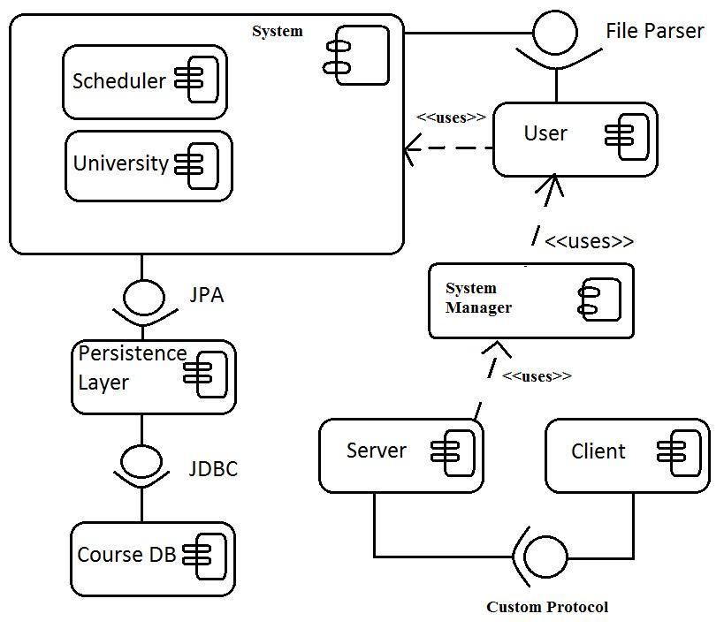
Components

Slide 5
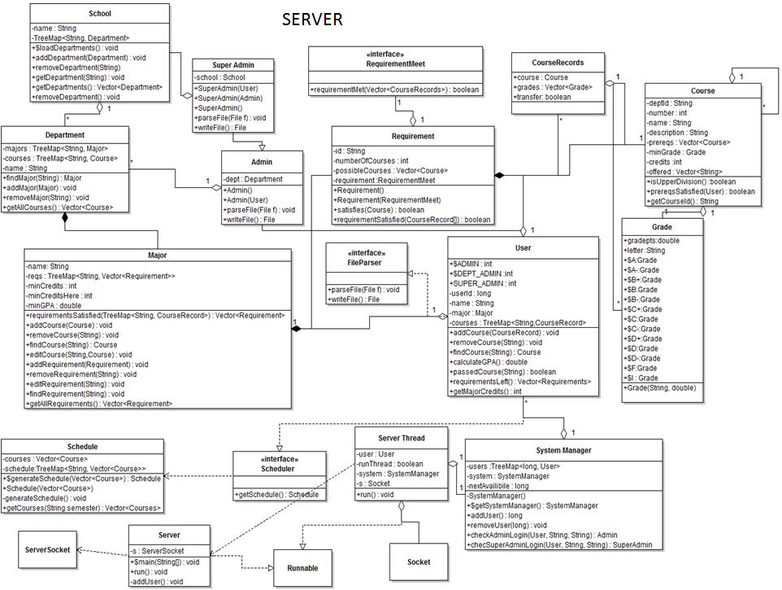
Server Class Diagram

Slide 6
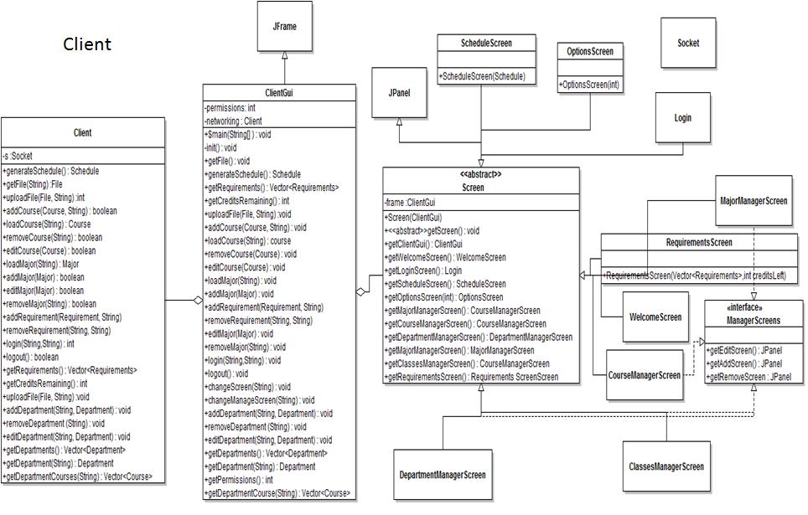
Client Class Diagram

Slide 7
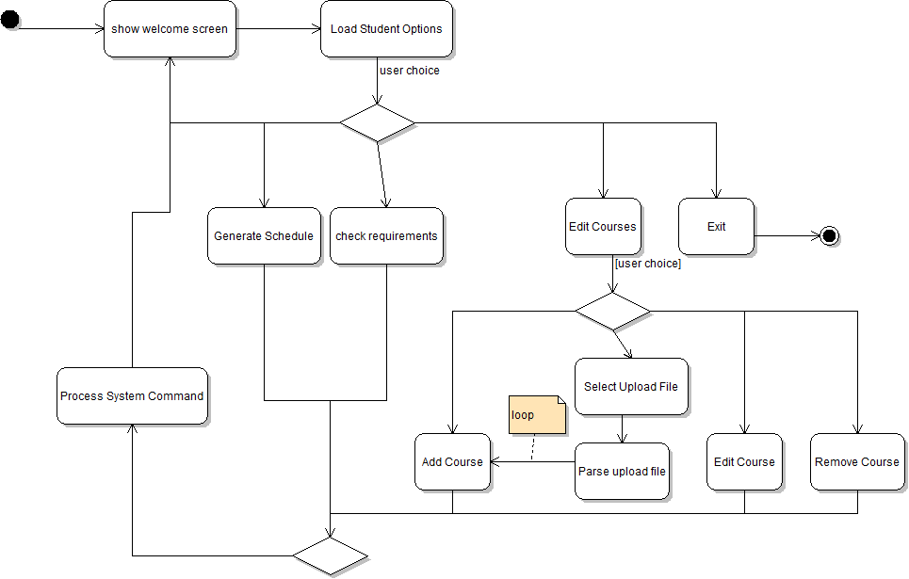
Student Activity Diagram

Slide 8
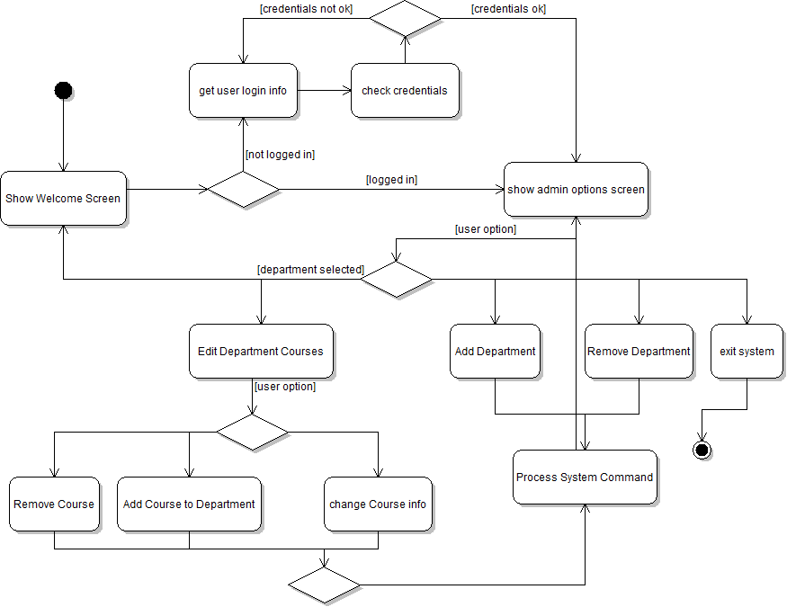
Registrar Admin Activity Diagram

Slide 9
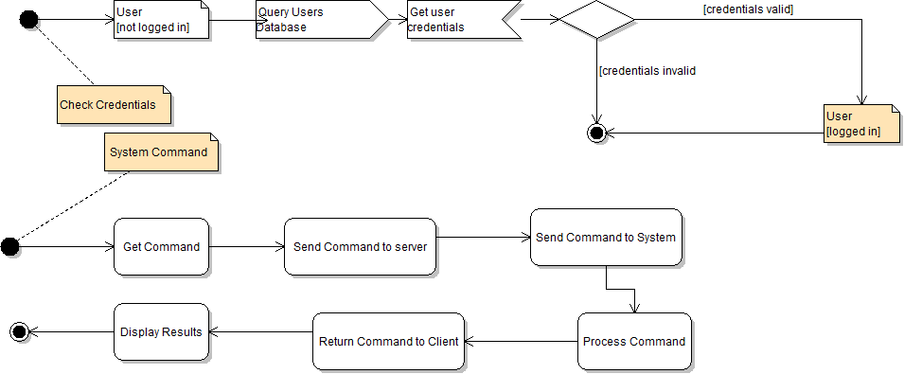
Activity Sub-diagrams

Slide 10
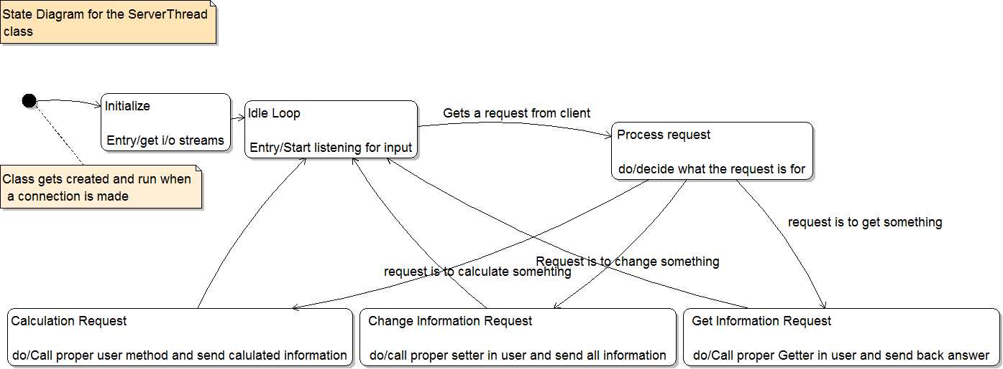
ServerThread State Diagram

Slide 11
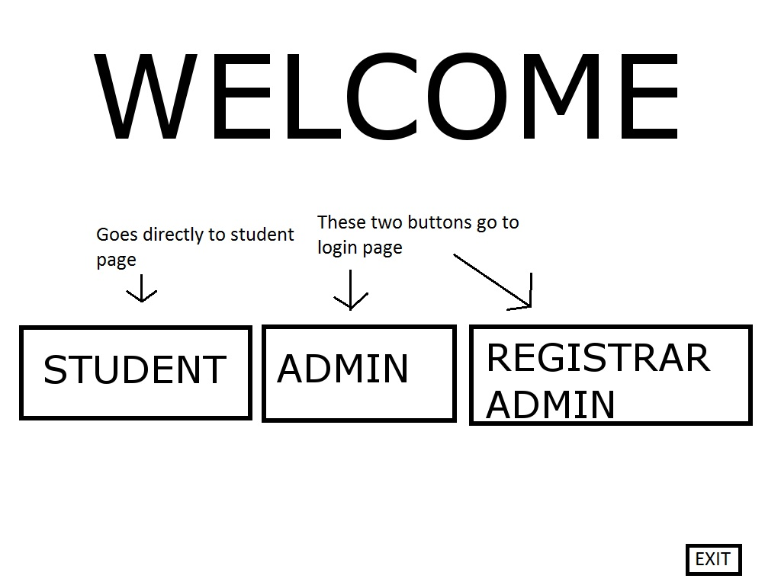
Initial GUI

Slide 12
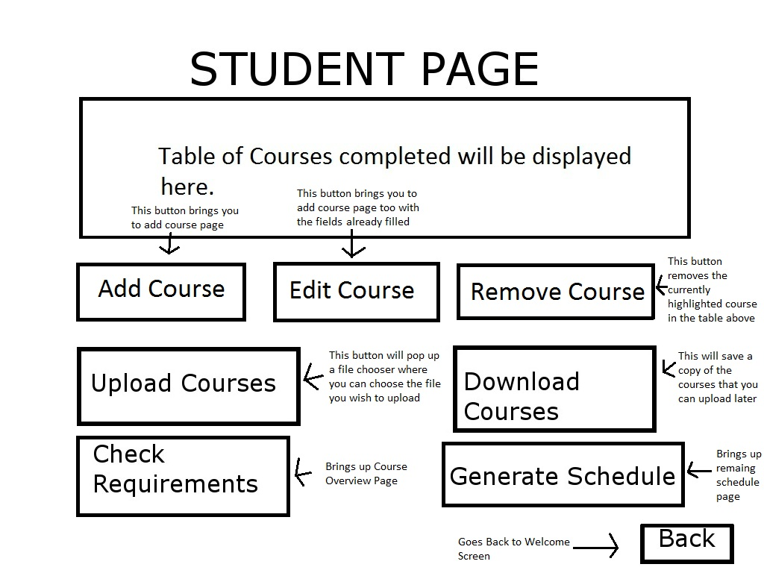
Main Student GUI

Slide 13
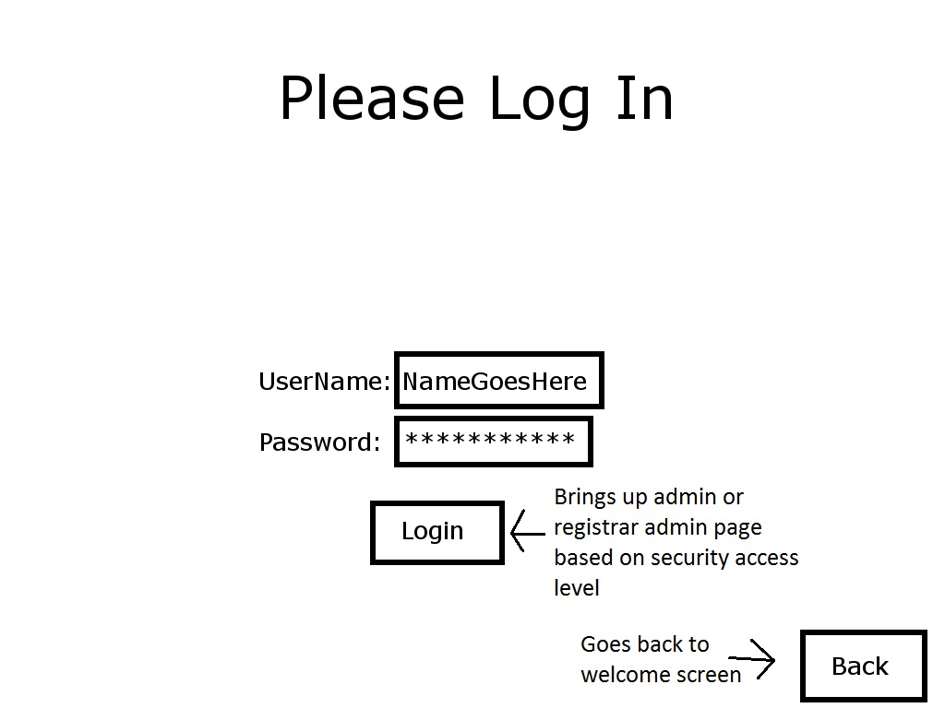
Login GUI

Slide 14
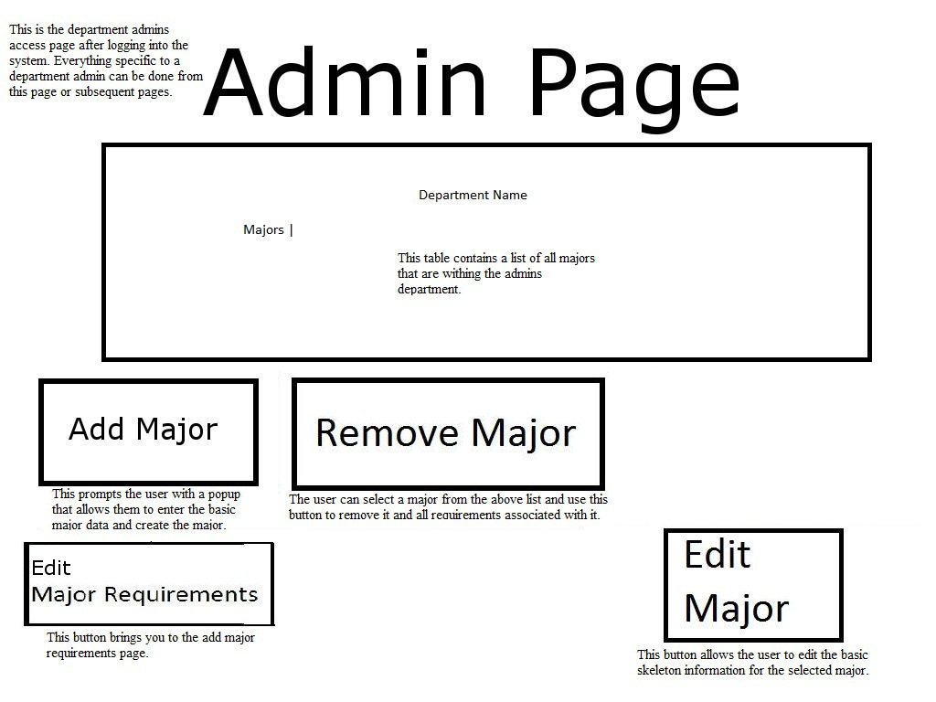
Department Administrator GUI

Slide 15
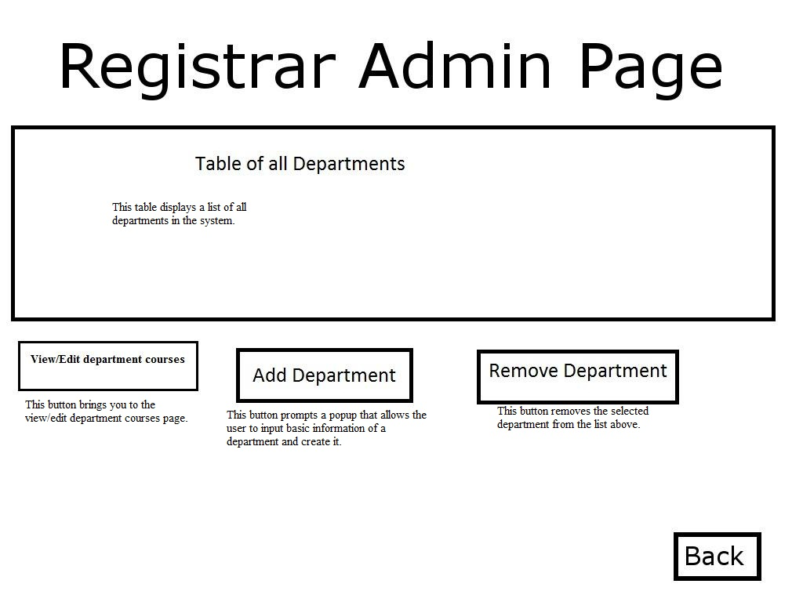
Registrar Administrator GUI

